Slide 1

Web Scraping to gain company insights
Task 2
By: Subhransu Sekhar Mallick

Slide 2
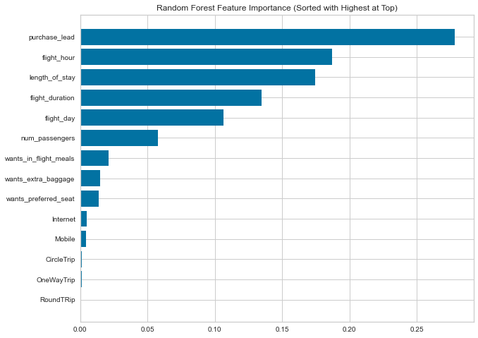
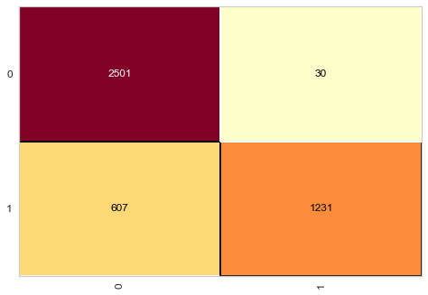
Predicting customer buying behaviour:
Random Forest model is employed on the data set after splitting into 75% training and 25% for testing.
Accuracy
62%
Precision
61%
Recall
59%
F1 Score
60%
AUC Score
61.5%
Feature Importance by Random Forest
The Given dataset was a imbalanced one which resulted in higher accuracy but lesser precision and recall.
For predicting the successful bookings, correctly, the Dataset was balanced by labelling 8k as incomplete bookings and 7k as completed bookings.
Evaluation Matrix

